Slide 1







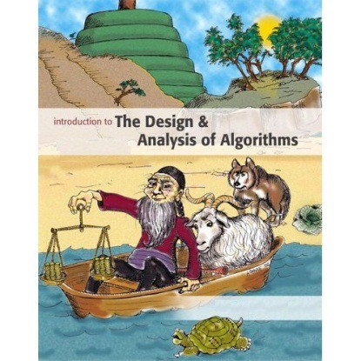
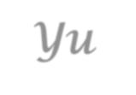
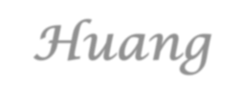

Introduction to
Algorithm Design and Analysis
[10] Union-Find
Yu Huang
http://cs.nju.edu.cn/yuhuang Institute of Computer Software Nanjing University

Slide 2

In the last class…
Hashing
Basic idea
Collision handling for hashing
Closed address
Open address
Amortized analysis
Array doubling
Stack operations
Binary counter

Slide 3



Union-Find
Dynamic Equivalence Relation
Examples
Definitions
Brute force implementations
Union-Find Set
Straight Union-Find
Making Shorter Tree by Weighted Union
Compressing Path by Compressing-Find

Slide 4

Minimum Spanning Tree
Kruskal’s algorithm, greedy strategy:
Select one edge
With the minimum weight
Not in the tree
Evaluate this edge
This edge will NOT result in a cycle
Critical issue:
How to know “NO CYCLE”?

Slide 5



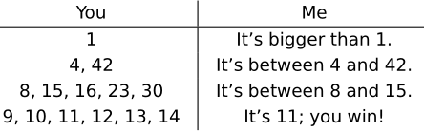
Guess My Number
– an Example
I pick a secret positive integer x
In each round, you write a list of numbers
You list at most x numbers
I told you the position of x
You must guarantee to win
What is the least number of rounds in the worst case?

Slide 6



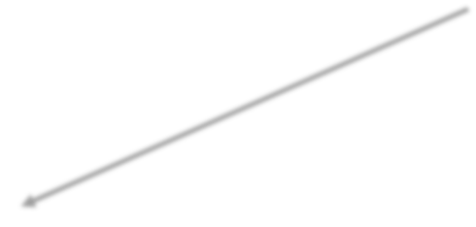

Maze Creation – an Example
inlet
Select a wall to pull down randomly
If i and j are in same equivalence class, then select another wall to pull down.
Otherwise, joint the two classes into one.
The maze is complete when the inlet and outlet are in one equivalence class.
outlet

Slide 7


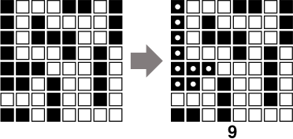
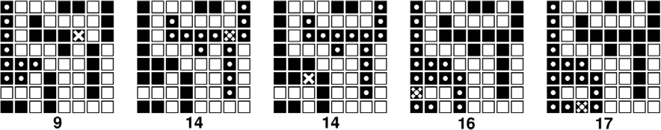
Black pixels – an Example
Maximum black pixel component
Let α be the size of the component
Color one pixel black
How α changes?
How to choose the pixel, to accelerate the change in α

Slide 8





Jigsaw Puzzle – an Example
Multiple pieces may be glued together
From “one player” to “two players”
Each group can only be moved in a mutual exclusive way
How to decide the relation of
“in the same group”

Slide 9


Dynamic Equivalence Relations
Equivalence
Reflexive, symmetric, transitive
Equivalent classes forming a partition
Dynamic equivalence relation
Changing in the process of computation
IS instruction: yes or no (in the same equivalence class)
MAKE instruction: combining two equivalent classes, by relating two unrelated elements, and influencing the results of subsequent IS instructions.
Starting as equality relation

Slide 10



Implementation: How to Measure
The number of basic operations for processing a sequence of m MAKE and/or IS instructions on a set S with n elements.
An Example: S={1,2,3,4,5}
o 0. [create] {{1}, {2}, {3}, {4}, {5}}
o 1. IS 2≡4? o 2. IS 3≡5? o 3. MAKE 3≡5. | No No | {{1}, {2}, {3,5}, {4}}
o 4. MAKE 2≡5. |  | {{1}, {2,3,5}, {4}}
o 5. IS 2≡3? | Yes
o 6. MAKE 4≡1. |  | {{1,4}, {2,3,5}}
o 7. IS 2≡4? | No

Slide 11




Union-Find based Implementation
The matrix problem
Each cell as a set
Randomly delete a wall and union two cells
Loop until you find the inlet and outlet are in one equivalent class
The Kruskal algorithm
Each node as a set
Choose the least weight edge (u,v)
Find whether u and v are in the same equivalent class
If not, add the edge and union the two nodes

Slide 12

Implementation: Choices
Matrix (relation matrix)
Space in Θ(n²), and worst-case cost in Θ(mn) (mainly for row copying for MAKE).
Array (for equivalence class id)
Space in Θ(n), and worst-case cost in Θ(mn) (mainly for search and change for MAKE).
Union-Find
A object of type Union-Find is a collection of disjoint sets
There is no way to traverse through all the elements in one set.

Slide 13

Union-Find ADT
Constructor: Union-Find create(int n)
o sets=create(n) refers to a newly created group of sets
{1}, {2}, ..., {n} (n singletons)
Access Function: int find(UnionFind sets, e)
o find(sets, e)=<e>
Manipulation Procedures
o void makeSet(UnionFind sets, int e)
o void union(UnionFind sets, int s, int t)

Slide 14



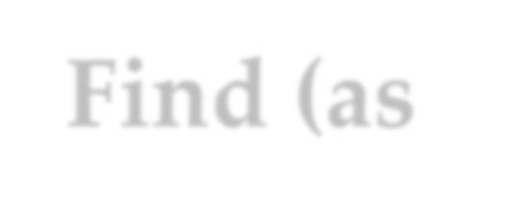





Using Union-Find (as inTree)
IS s_{i} ≡ s_{j} :
o t=find(s_{i});
implementation by inTree
create(n): sequence of makeNode
0 1 i n-1
o u=find(s );
j
n
o (t==u)?
MAKE s_{i} ≡ s_{j} :
o t=find(s );
u
_{u} union(t,u)
t
setParent(t,u)
i
o u=find(s_{j});
o union(t,u);
find(s_{j})=u
parent^{k}(s_{j})
s_{j}

Slide 15


Union-Find Program
A union-find program of length m
o is (a create(n) operation followed by) a sequence of m
union and/or find operations interspersed in any order.
A union-find program is considered an input, the object for which the analysis is conducted.
The measure: number of accesses to the
parent
o assignments: for union operations
link operation
o lookups: for find operations

Slide 16





Worst-case Analysis for Union-Find Program
Assuming each lookup/assignment take Ο(1).
Each makeSet or union does one assignment, and each find does d+1 lookups, where d is the depth of the node.
Union(1,2)
Union(2,3)
The sequence of Union makes a chain of length n-1, which is the tree with the largest height
n-1. Union(n-1,n)
n. Find(1)
operations done:
n+(n-1)+(m-n+1)n
Θ (mn)
m. Find(1)
Example
Find(1) needs n
array lookups

Slide 17



Weighted Union: for Short Trees
Weighted union: always have the tree with fewer nodes as subtree. (wUnion)
To keep the Union valid, each Union operation is replaced by:
t=find(i); u=find(j); union(t,u)
2
Not the worst
n
case!
1
3
n-1
Tree made by wUnion
The order of (t,u) satisfying the requirement
Cost for the program:
n+3(n-1)+2(m-n+1)

Slide 18

Upper Bound of Tree Height
After any sequence of Union instructions, implemented by wUnion, any tree that has k nodes will have height at most ⎣lgk⎦
Proof by induction on k:
base case: k=1, the height is 0.
by inductive hypothesis:
h₁≤ ⎣lgk₁⎦, h₂≤ ⎣lgk₂⎦
o h=max(h1, h2+1), k=k1+k2
if h=h₁, h≤ ⎣lgk₁⎦≤ ⎣lgk⎦
if h=h₂+1, note: k₂≤k/2 so, h₂+1≤ ⎣lgk₂⎦+1≤ ⎣lgk⎦
t
u
T
1
T
2
k₁ nodes
height h₁
k₂ nodes
height h₂
T
k nodes height h

Slide 19




Upper Bound for Union-Find Program
A Union-Find program of size m, on a set of n elements, performs O(n+mlogn) link operations in the worst case if wUnion and straight find are used.
Proof:
At most n-1 wUnion can be done, building a tree with height at most ⎣logn⎦,
Then, each find costs at most ⎣logn⎦+1.
Each wUnion costs in Ο(1), so, the upper bound on the cost of any combination of m wUnion/find operations is the cost of m find operations, that is m(⎣logn⎦+1)∈ Ο (n+mlogn)
There do exist programs requiring Ω(n+(m-n)logn) steps.

Slide 20




Path Compression
Path compressed
x
w
v
v
w
x
Change their parents to the root

Slide 21



Challenges for the Analysis
Path compressed
x
w
v
v
w
x
cFind does twice as many link operations as the find does for a given
cFind will traverse
node in a given tree.
shorter paths
but…

Slide 22

Analysis: the Basic Idea
cFind may be an expensive operation
o in the case that find(i) is executed and the node i has great depth.
However, such cFind can be executed only for limited times
o in contrast to other operations of lower cost.
So, amortized analysis applies

Slide 23



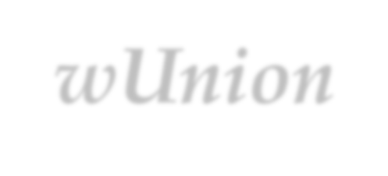

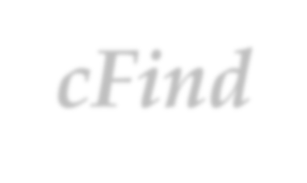
Co-Strength of
wUnion and cFind
O((n+m)log*(n))
Link operations for a Union-Find program of length m on a set of n elements is in the worst case.
Implemented with
wUnion and cFind
What’s log*(n)?
o Define the function H as following:
H (0) = 1
⎧
⎨
H (i−1)
⎩
H (i) = 2 for i > 0
o Then, log*(j) for j≥1 is defined as:
log*(j)=min{ k|H(k)≥j }

Slide 24


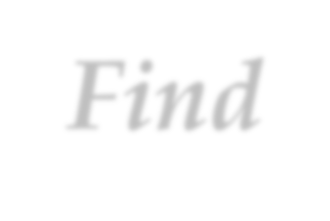




Definitions with a Union- Find Program P
Forest F: the forest constructed by the sequence of union instructions in P, assuming:
o wUnion is used;
o the finds in the P are ignored
Height of a node v in any tree: the height of the subtree rooted at v
Rank of v: the height of v in F
Note: cFind changes the height of a node, but the rank for any node is invariable.

Slide 25


Constraints on Ranks in F
The upper bound of the number of nodes with
n
rank r (r≥0) is
₂r
Remember that the height of the tree built by wUnion is at most ⎣lgn⎦, which means the subtree of height r has at least 2^{r} nodes.
The subtrees with root at rank r are disjoint.
There are at most ⎣logn⎦ different ranks.
o There are altogether n elements in S, that is, n nodes in F.

Slide 26


Increasing Sequence of Ranks
The ranks of the nodes on a path from a leaf to a root of a tree in F form a strictly increasing sequence.
When a cFind operation changes the parent of a node, the new parent has higher rank than the old parent of that node.
o Note: the new parent was an ancestor of the previous parent.

Slide 27


A Function Growing Extremely Slowly
Function H:
H(0)=1
Function Log-star
log*(j) is defined as the least i such that:
H(i)≥j for j>0
Log-star grows extremely slowly
2
H(i+1)=2^{H (i)}
₂2
k 2’s
that is: H(k)=2
Note:
H grows extremely fast: H(4)=2¹⁶=65536 H(5)=2⁶⁵⁵³⁶
log* ( n )
lim
n→∞
= 0
( p )
log n
p is any fixed nonnegative
constant
For any x: 2¹⁶≤x≤2⁶⁵⁵³⁶-1, log*(x)=5 !

Slide 28

Grouping Nodes by Ranks
Node v∈s_{i} (i≥0) iff. log*(1+rank of v)=i
o which means that: if node v is in group i, then
r_{v} ≤ H(i)-1, but not in group with smaller labels
So,
Group 0: all nodes with rank 0
Group 1: all nodes with rank 1
Group 5 exists only when n is at least 2⁶⁵⁵³⁶. What is that?
Group 2: all nodes with rank 2 or 3
Group 3: all nodes with its rank in [4,15]
Group 4: all nodes with its rank in [16, 65535]
Group 5: all nodes with its rank in [65536, ???]

Slide 29




Very Few Groups
Node v∈S_{i} (i≥0) iff.
log*(1+rank of v)=i
If log*(n+1)=k, then
k 2’s
₂ 2
Upper bound of the number of distinct node groups is log*(n+1)
o The rank of any node in F is at most ⎣logn⎦, so the largest group index is log*(1+ ⎣logn⎦)=log*(⎡logn+1⎤) = log*(n+1)-1
2
2
≥n+1
(k-1) 2’s
₂ 2
2
≥log(n+1)

Slide 30


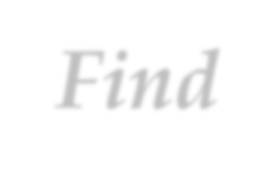
Amortized Cost of Union- Find
Amortized Equation Recalled
amortized cost = actual cost + accounting cost
The operations to be considered:
o n makeSets
o m union & find (with at most n-1 unions)

Slide 31

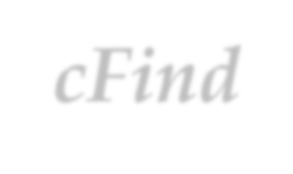
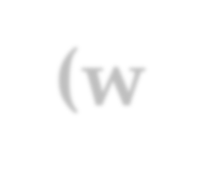









One Execution of cFind(w₀)
Root=w_{k}
Only when k=0,1, there is no parent change
Groups in a strict increasing order
w
k-1
For one cFind operation, the actual cost is 2k Not 2(k+1)
Group Boundary
w_{i}
^{w}i-1
Accounting cost is -2 for each pair of (w_{i-1}, w_{i}) for the the 2 nodes in ths same group only, which we call a withdrawal.
Note: the ranks are not consecutive generally
v=w₀

Slide 32

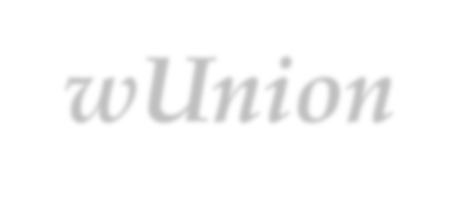


Amortizing Scheme for
wUnion-cFind
makeSet
Accounting cost is 4log*(n+1)
So, the amortized cost is 1+4log*(n+1)
wUnion
Accounting cost is 0
So the amortized cost is 1
cFind
Accounting cost is describes as in the previous page.
o Amortized cost ≤ 2k-2((k-1)-(log*(n+1)-1))=2log*(n+1) (Compare with the worst case cost of cFind, 2logn)
Number of withdrawal

Slide 33


Validation of the Amortizing Scheme
We must be assure that the sum of the accounting costs is never negative.
The sum of the negative charges, incurred by cFind, does not exceed 4nlog*(n+1)
o We prove this by showing that at most 2nlog*(n+1) withdrawals on nodes occur during all the executions of cFind.

Slide 34

Key Idea in the Derivation
For any node, the number of withdrawal will be less than the number of different ranks in the group it belongs to
When a cFind changes the parent of a node, the new parent is always has higher rank than the old parent.
Once a node is assigned a new parent in a higher group, no more negative amortized cost will incurred for it again.
The number of different ranks is limited within a group.

Slide 35

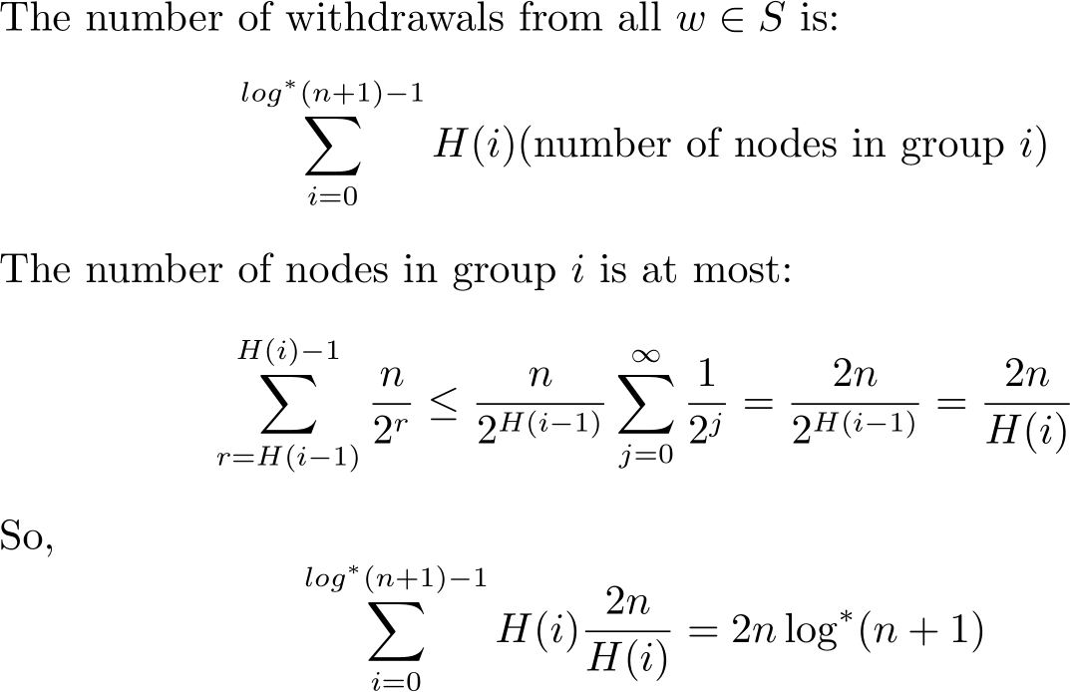
Derivation
Bounding the number of withdrawals
a loose upper bound of ranks in a group

Slide 36

Conclusion
The number of link operations done by a Union-Find program implemented with wUnion and cFind, of length m on a set of n elements is in O((n+m)log*(n)) in the worst case.
o Note: since the sum of accounting cost is never negative, the actual cost is always not less than amortized cost. The upper bound of amortized cost is: (n+m)(1+4log*(n+1))

Slide 37


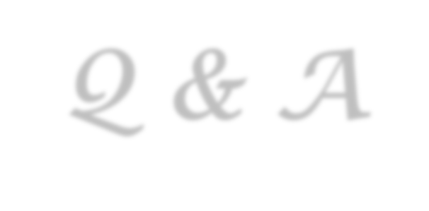

Thank you!
Q & A
Yu Huang
http://cs.nju.edu.cn/yuhuang

